Slide 1


HuBMAP + HPA - Hacking the Human Body Competition
Presentation of a Report By
Juntuo Wang, Yufeng Gao

Slide 2
Overview
A Introduction of Competition:
Some information of this competition: The Dataset, etc.
The Plan of Hacking This Competition:
Some Possible Baselines, Data Augmentation, Future Plan
Analysis of results:
Comparison analysis between different baselines (FPN, UNet and UNet++）

Slide 3
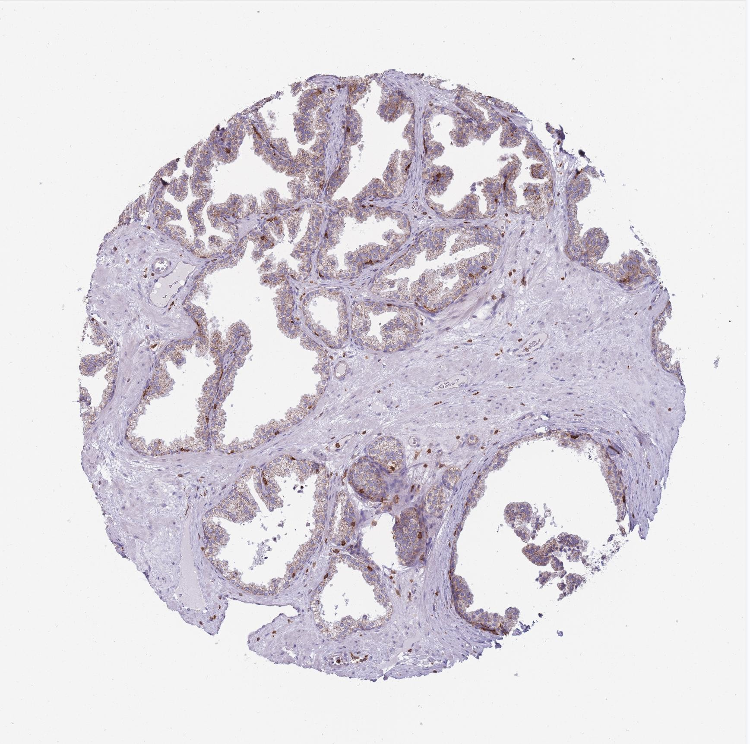
Part 1: Introduction of Competition
The Goal of The Competition:
The goal of this competition is to identify the locations of each functional tissue unit (FTU) in biopsy slides from several different organs.
Dataset:
Data Source: This competition uses data from two different consortia, the Human Protein Atlas (HPA) and Human BioMolecular Atlas Program (HuBMAP).
Challenge: When encountering data prepared using different protocols, how to adapt the model to function properly will be one of the core challenges of this competition.

Slide 4
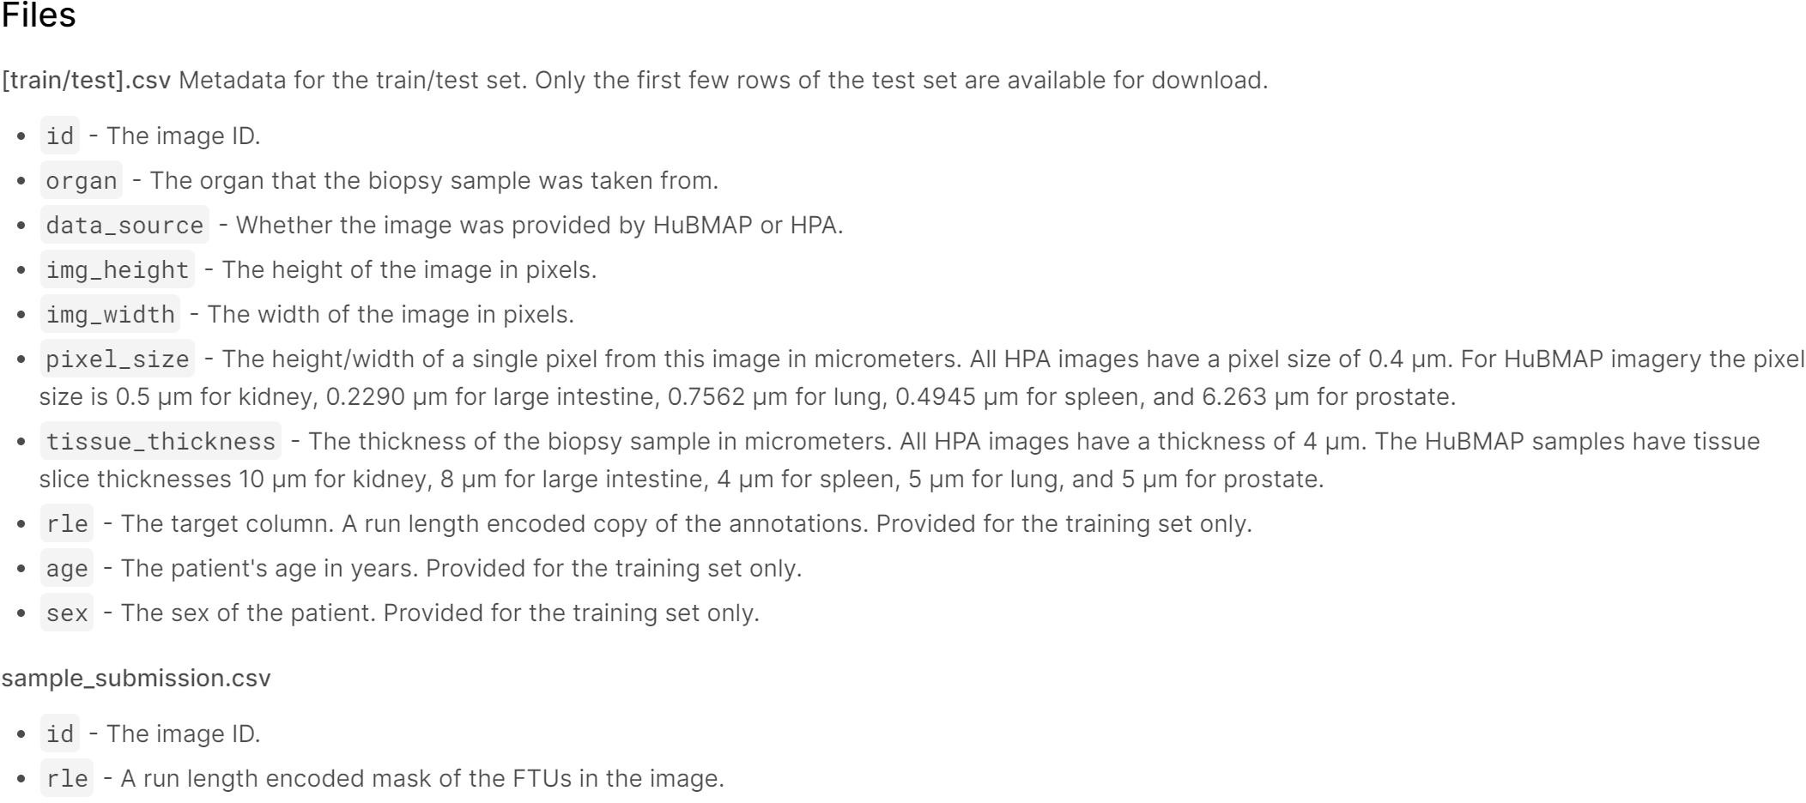
Part 1: Introduction of Comepetition
Dataset Content:
One test image
351 train images

Slide 5
Part 1: Introduction of Comepetition
Train Image Annotation:
A run length encoded mask of the FTUS in the image
Instead of using an exhaustive list of indices for the Image annotation, this competition ueses pairs of values that contain a start position and a run length. E.g. '1 3' implies starting at pixel 1 and running a total of 3 pixels 1, 2, 3
In addition, the competition format requires a space delimited list of pairs. For example, '1 3 10 5' implies pixels 1,2,3,10,11,12,13,14 are to be included in the mask. The metric checks that the pairs are sorted, positive, and the decoded pixel values are not duplicated. The pixels are numbered from top to bottom, then left to right: 1 is pixel (1,1), 2 is pixel (2,1), etc.

Slide 6
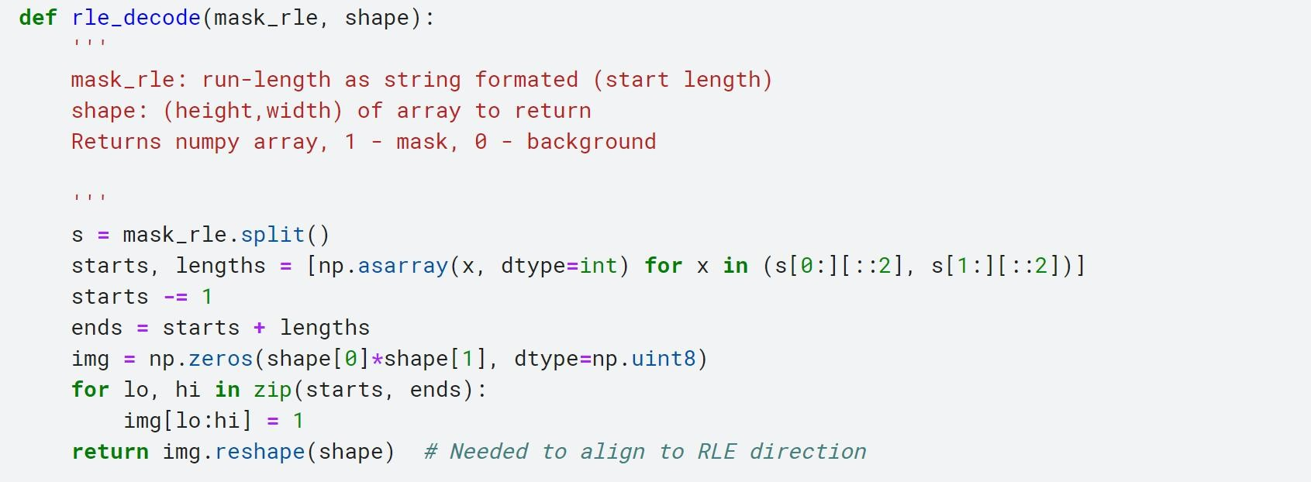
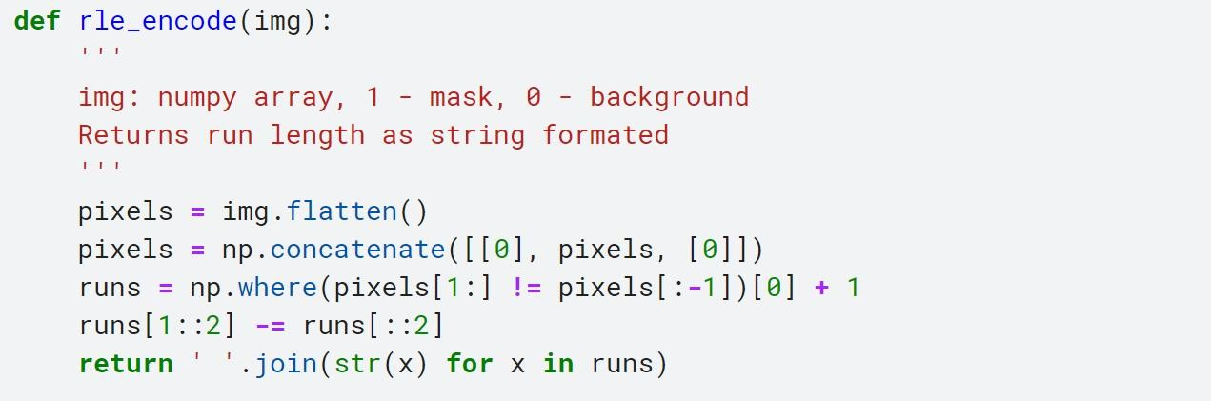
Part 2: Plan of Hacking This Competition
Helper Function
Reference
# ref: https://www.kaggle.com/paulorzp/run- length-encode-and-decode
# ref.: https://www.kaggle.com/stainsby/fast- tested-rle

Slide 7
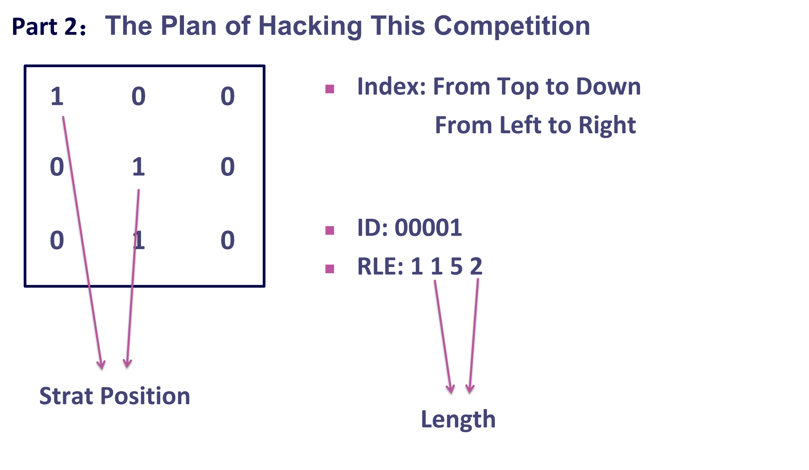

Slide 8
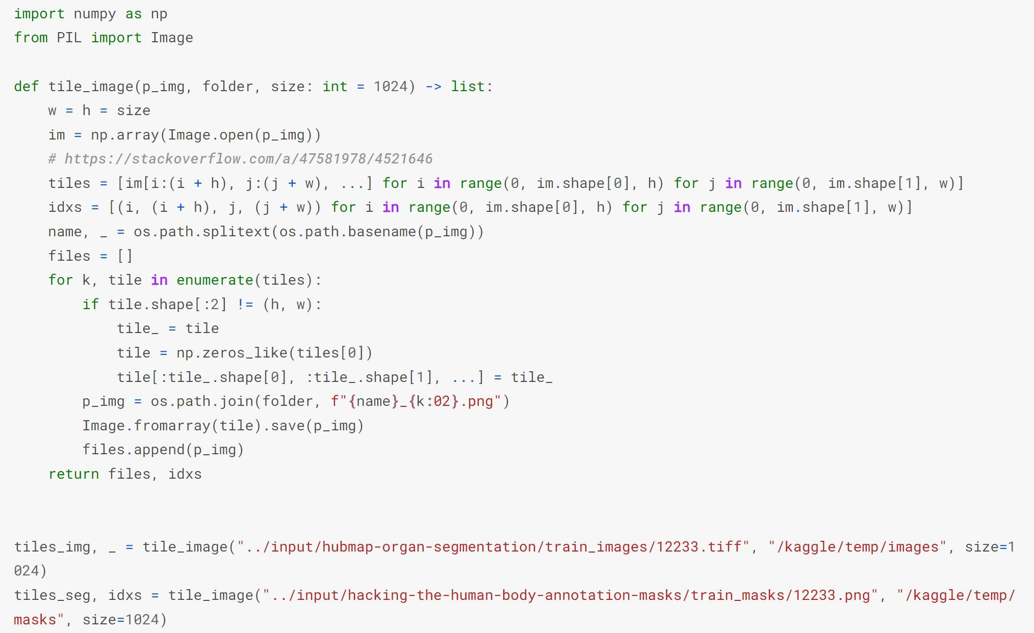
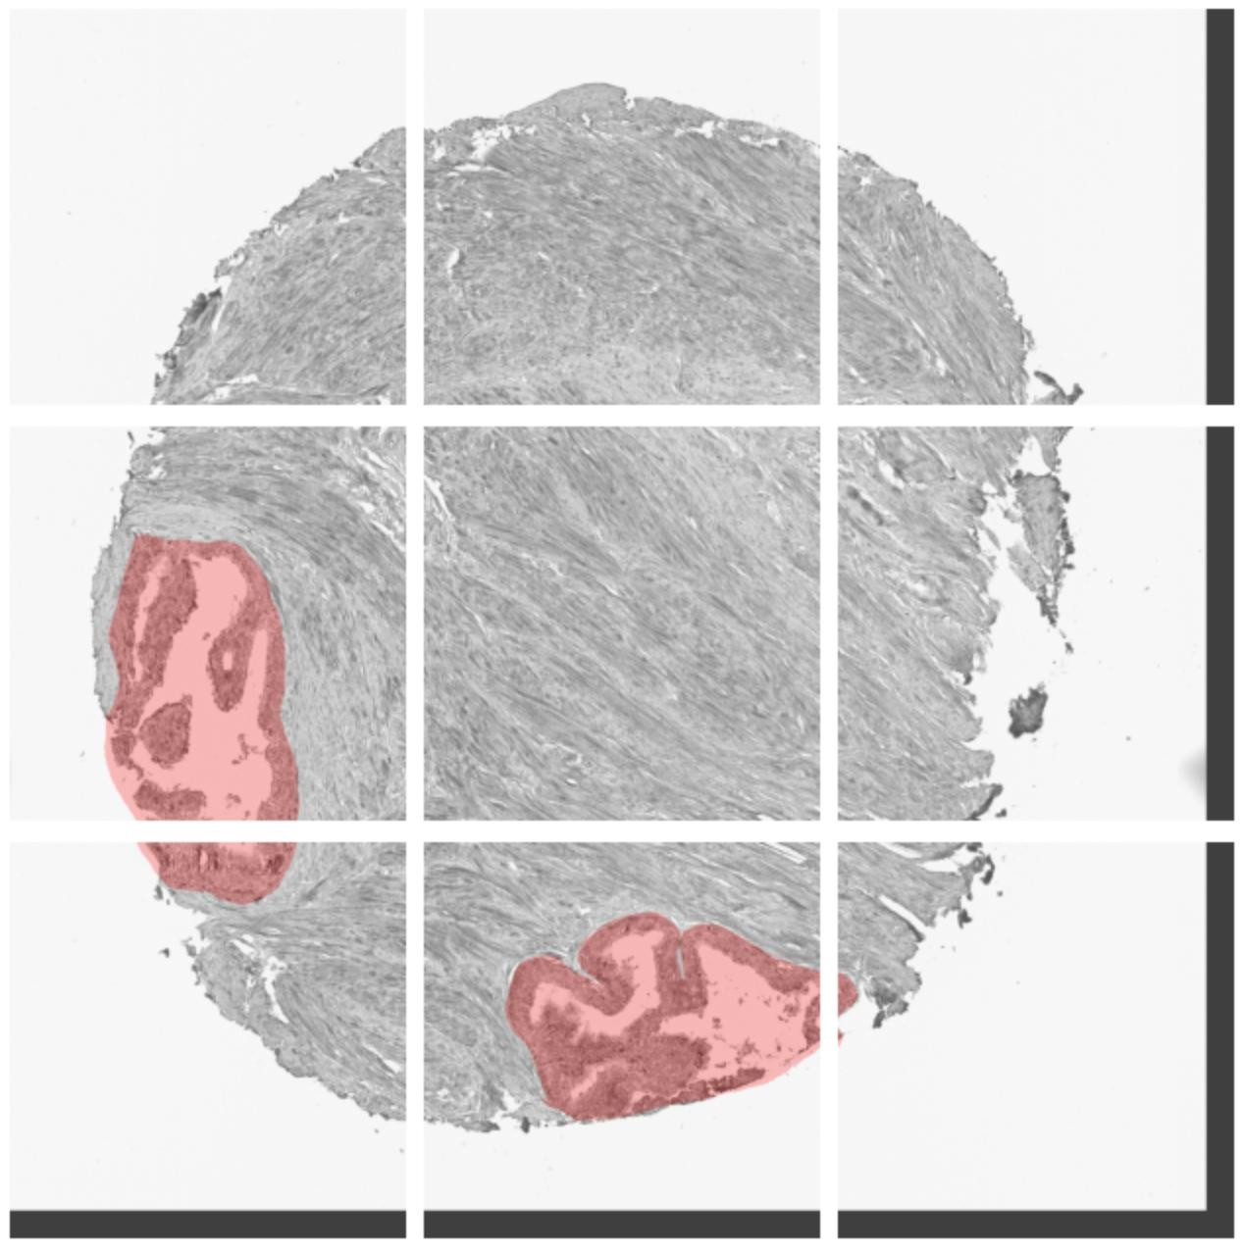
Part 2: Plan of Hacking This Competition
Patch the Image

Slide 9
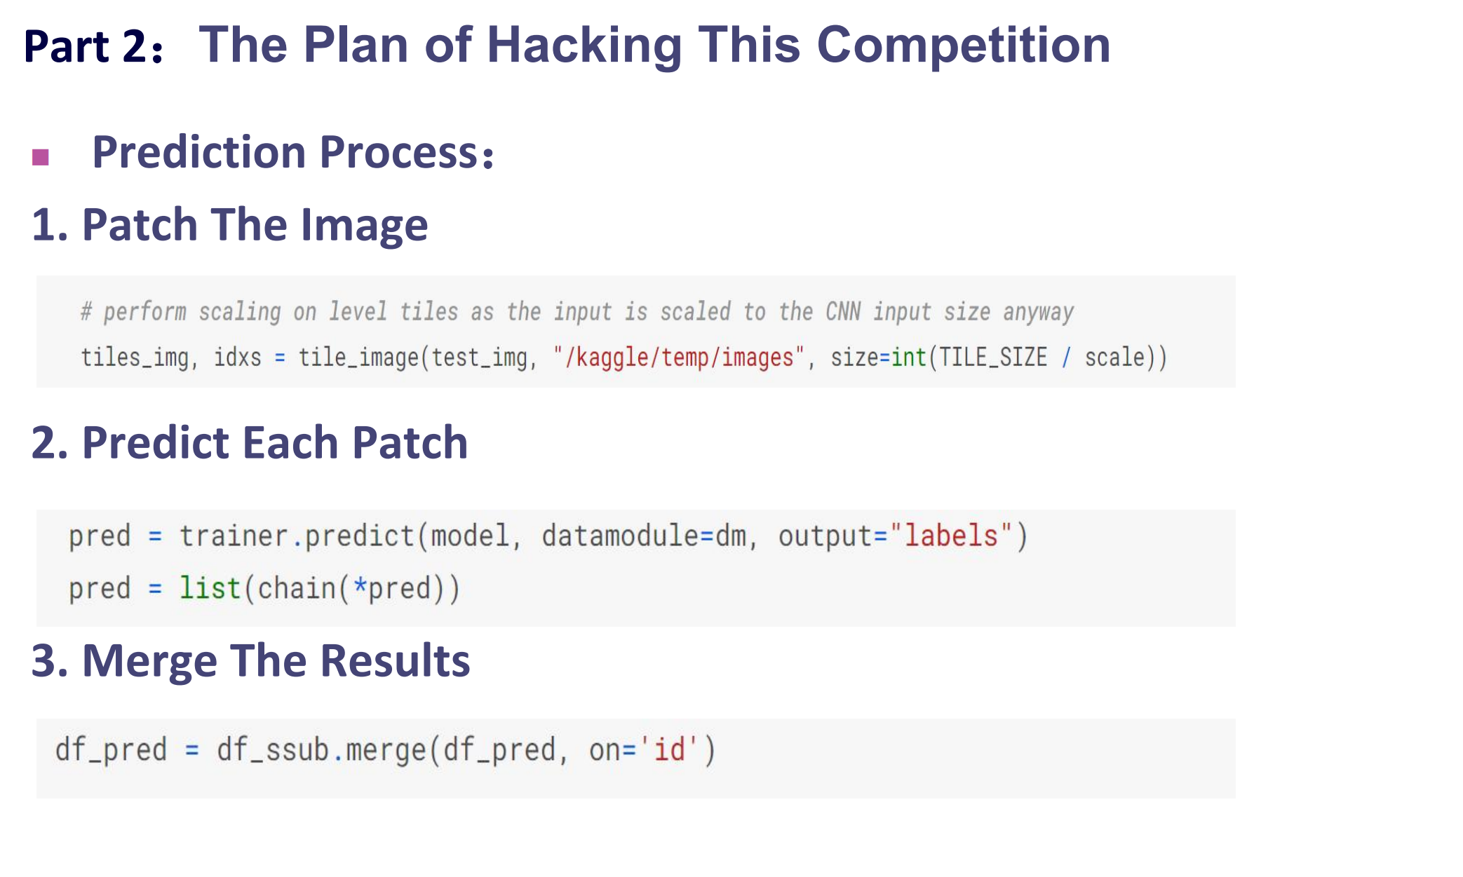

Slide 10
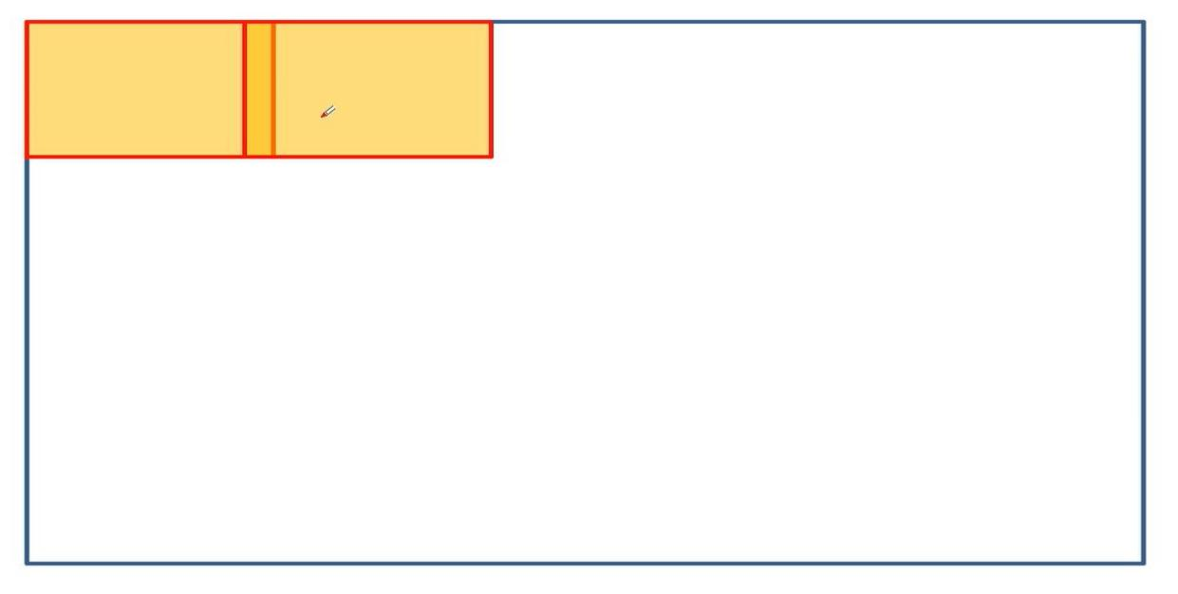
Part 2: Plan of Hacking This Competition
Patch the Image (Something could be improved)
When splitting the image into different patches, as shown in Figure, we can make the two adjacent patches have some overlap between them, the purpose of doing this is to better segment the information in the boundary area.
If we don't use this method, then for the edge region of one patches, it doesn't utilize the image information on the other side, which may result in inaccurate results

Slide 11
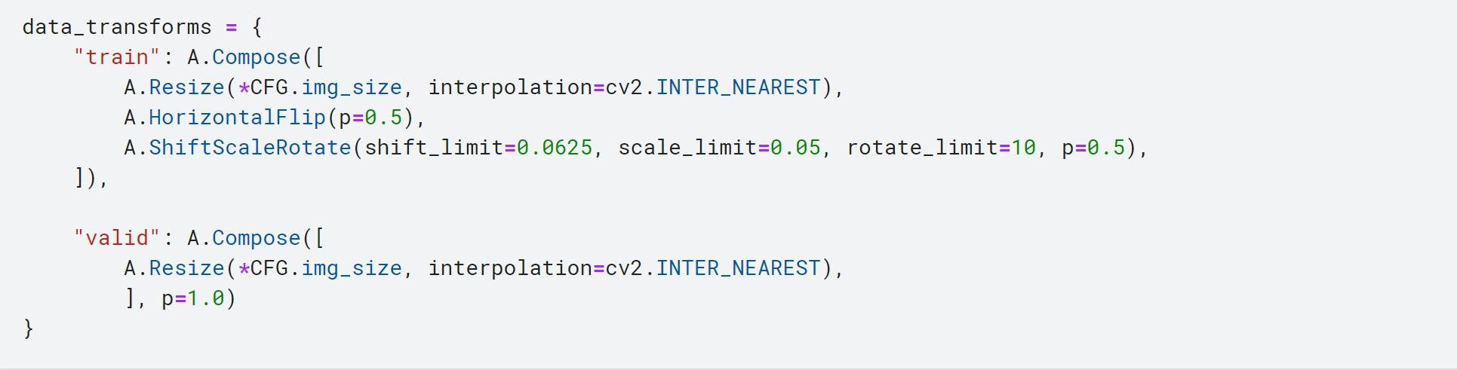
Part 2: Plan of Hacking This Competition
Data Augmentation (Used in Baseline)
Candidate methods
Horizontal flip: Horizontal mirror images help to increase directional invariance (e.g. pedestrians can appear in different directions).
Panning: moving the image will prevent the CNN from always seeing the same position of the training image.
Random cropping and scaling: Random image resizing helps the model see different proportions of each object and improves the network's invariance to different image resolutions

Slide 12

Part 2: Evaluation
Evaluation:
Dice Coefficient
This competition is evaluated on the mean Dice coefficient. The Dice coefficient can be used to compare the pixel-wise agreement between a predicted segmentation and its corresponding ground truth. The formula is given by:
Where X is the predicted set of pixels and Y is the ground truth. The Dice coefficient is defined to be 1 when both X and Y are empty. The leaderboard score is the mean of the Dice coefficients for each image in the test set.

Slide 13
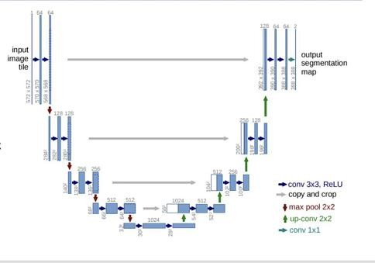
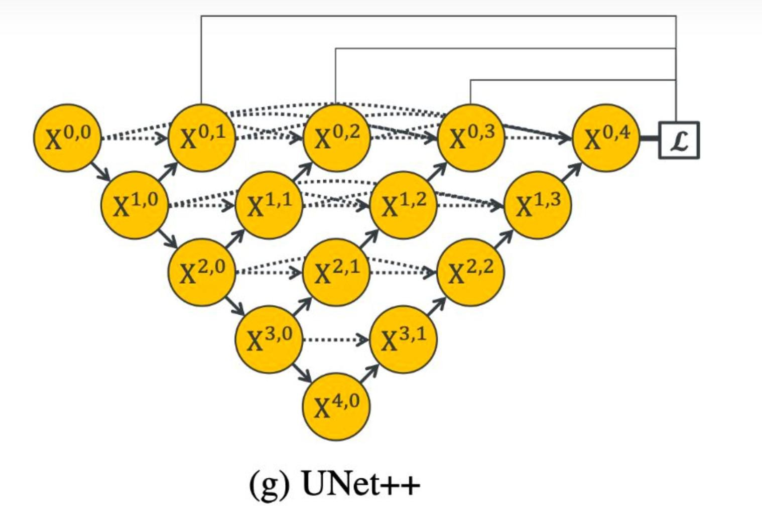
Part 3: Analysis of results
Some Possible Baselines
FPN (Feature Pyramid Networks)
UNet
UNet++

Slide 14
Thank you !

